Slide 1
AutoEncoders
Presented by
Gande Akhila
PG-ID:1931014

Slide 2
Contents
Introduction
Why Autoencoders
Use of Autoencoders
How does Autoencoders work?
Pros and cons of Autoencoders
Applications of Autoencoders
Python code walk through
Conclusion/Takeaways

Slide 3
Introduction
●
Autoencoders (AE) are a family of neural networks for which the input is the same as the output. Primarly, a neural network architecture.
Part of the unsupervised learning paradigm
They work by compressing the input into a lesser dimensional space representation and then reconstructing the output from this representation.
Why Autoencoders?
Despite the fact, the practical applications of autoencoders were pretty rare some time back, today data denoising and dimensionality reduction for data visualization are considered as two main interesting practical applications of autoencoders.
With appropriate dimensionality and sparsity constraints, autoencoders can learn data projections that are more interesting than PCA or other basic techniques
●
●
●
●

Slide 4



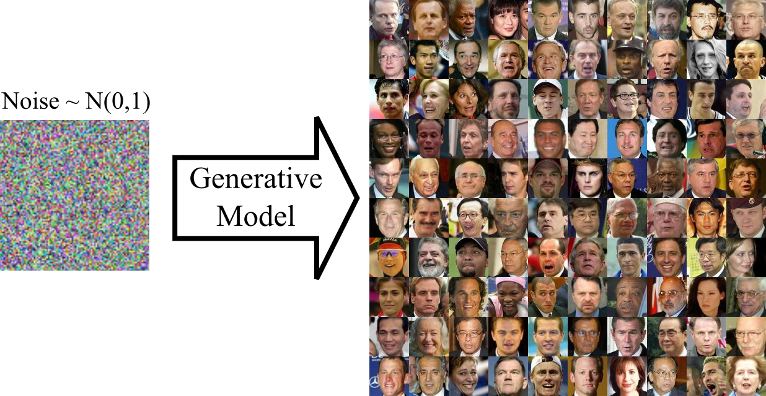

Why use Autoencoders?​
For example, we could train an
autoencoder on pictures of faces, and it would then be able to generate new faces​'

Slide 5
How do autoencoders work?
●
Autoencoders are structured to take an input, transform this input into a different representation, an embedding of the input.
●
From this embedding, it aims to reconstruct the original input as precisely as possible. It basically tries to copy the input.
●
The layers of the Autoencoder that create this embedding are called the encoder, and the layers that try to reconstruct the embedding into the original input are called decoder.
Usually Autoencoders are restricted in ways that allow them to copy only approximately. Because the model is forced to prioritize which aspects of the input should be copied, it often learns useful properties of the data.
●

Slide 6

PROS OF AUTO ENCODERS
* Learns data Encoding, reconstruction, generation
* Easy to sample latent space for good data generation, interpolation.
* unlike alternative generative models like gan's, training is stable

Slide 7
Cons of Autoencoders:
* If image data is used, then generated images are often blurry.
* The pixel distance term in the loss may not always be the best choice.
* Generated data not as good as state-of-the-art Gans of today.

Slide 8
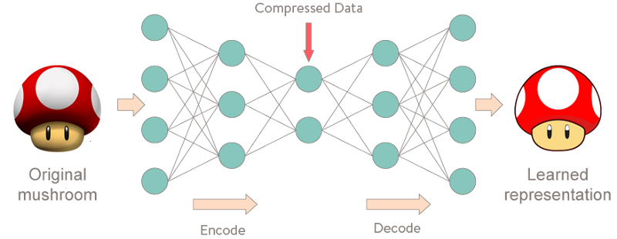
Neural Network architecture
●

Slide 9
Applications
Reconstruction with lesser dimensions -- 1 Image denoising -- 2
PHY layer design(Not in context today, you may want to refer the work of a startup called deepsig.io)
●
●
●

Slide 10
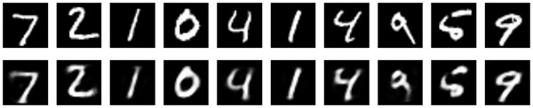
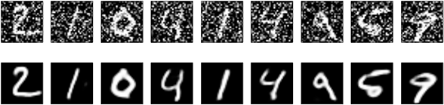
Input and Output Results
●
1

Slide 11
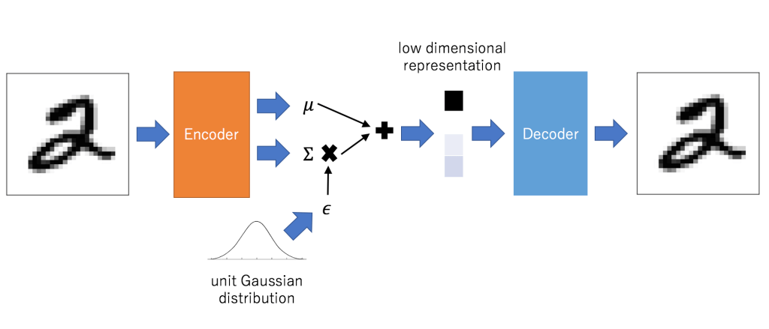
Pictorial view of reconstruction with lesser dimensions
●

Slide 12
Python code for reconstruction with lesser dimension
Data preparation
Layer specification
Compiling and training
autoencoder Predicting
Plotting
●
●
●
●
●

Slide 13
Conclusion/Take-aways
●
A peek into the world neural networks and in particular autoencoders
Framework for moving from away from hand- engineered algorithms to inference based
Joint optimisation vs unit-level optimisation
KPI in GPU context is Inferences per second to what was formerly instructions per second
●
●
●

Slide 14


